Slide 1
Crime in Toronto Neighborhoods
By Rishabh Agarwal

Slide 2
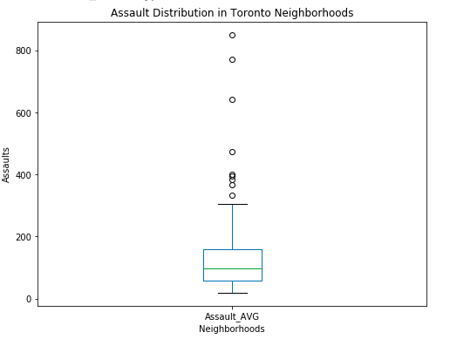
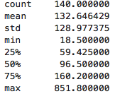
Average Assaults in Toronto
In Toronto neighborhoods, we see an average of 96.5 assaults in each neighborhood with a minimum of 18.5 and a maximum of 851.8 on average per year. Most of the data lies in the 59.42 assaults per year to 160.2 assaults per year range.

Slide 3
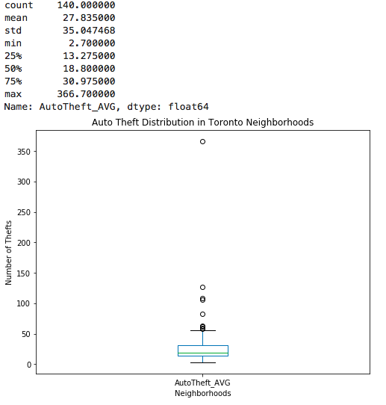
Average Auto-Thefts in Toronto
In Toronto, we see an average of 18.8 auto-thefts per year with a 2.7 minimum and a 366.7 maximum. Most of the data lies in the range of 13.275 to 30.975 auto-thefts per year

Slide 4
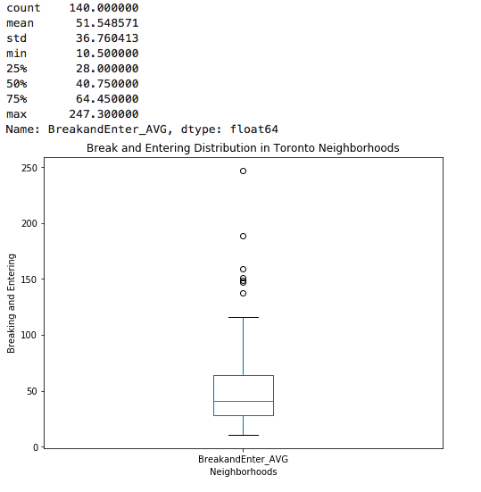
Average Breaking and Entering Numbers in Toronto
In Toronto, we see a 40.75 average breaking and entering per year each neighborhood with a 10.5 minimum and a 247.3 maximum. Most of the data lies in the 28 to 64.45 Breaking and Entering per year per neighborhood.

Slide 5
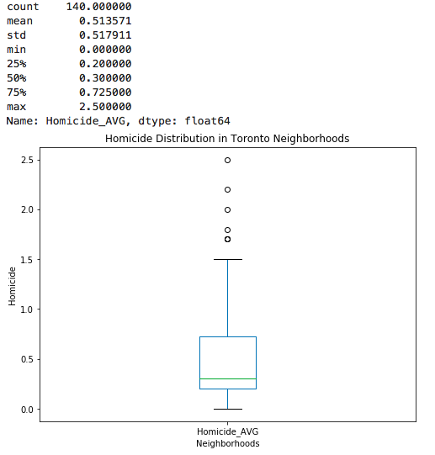
Average Homicides in Toronto
In Toronto, an average of .3 homicides happen per year per neighborhood with a minimum of 0 and a maximum of 2.5. Most of the data lies in the .2 to .725 homicides per year range

Slide 6
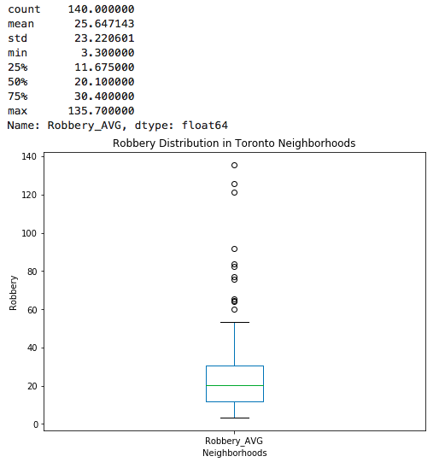
Average Robberies in Toronto
In Toronto, we see an average of 20.1 robberies per year per neighborhood with a minimum of 3.3 and a maximum of 135.74
Most of the data lies in the 11.675 to 30.4 robberies per year per neighborhood

Slide 7
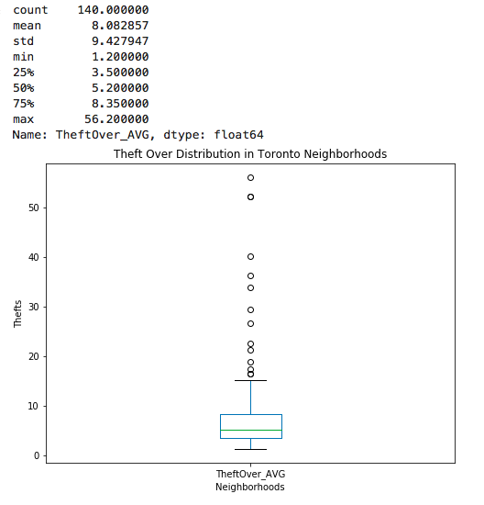
Average Theft Overs in Toronto
The average number of Theft Overs per year per neighborhood is 5.2 with a minimum of 1.2 and a maximum of 56.2.
The majority of the data lies in the 3.5 to 8.35 Theft Overs per year per neighborhood.

Slide 8
Clustering of Neighborhoods
Using all of this data, we will first normalize the data to find the z-score of each value and sum all these together to create a normalized method of comparing crimes in each neighborhood.
These values will be positive if crime is above average with highly positive numbers being very above average and vice versa
Then, a k-means clustering system will be used to cluster them and the neighborhoods will be displayed using a folium map.

Slide 9
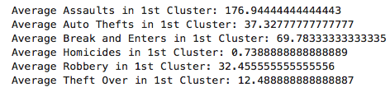
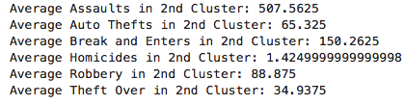
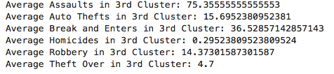
Cluster Data
In this data, we see the highest amount of crime happens in Cluster 2 which will be symbolized in the map as 1 and will be shown in light red.
The middle amount of crime will be symbolized by the 1st cluster shown as cluster 0 and in yellow on the map
The lowest amount of crime will be symbolized by the 3rd Cluster shown as cluster 2 and in dark red in the map

Slide 10
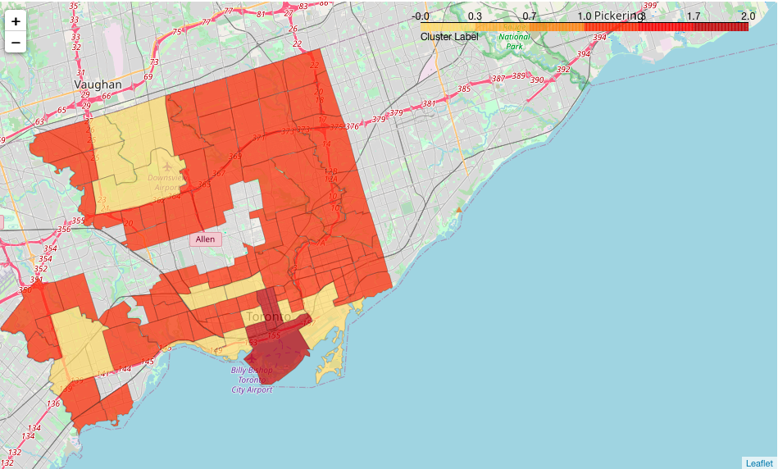
Folium Map

Slide 11
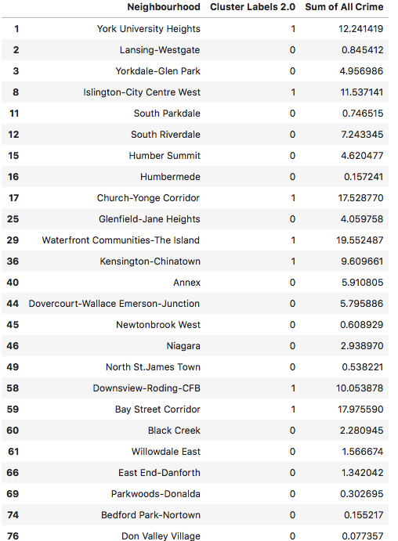
Neighborhoods to Avoid
In this dataset, we would desire to stay away from the high and medium levels of crime neighborhoods
The list of these neighborhoods are shown
Out of 121 neighborhoods, only 26 show characteristics of strong crime

